Slide 1


SENTIMENT ANALYSIS OF IMDB REVIEWS ☺ ☹
Presented by:
Rachit Kumar Singh 202118015
Akanksha Porwal 202118017
Dipshi Jain 202118018
Jenil Doshi 202118034

Slide 2
INTRODUCTION
Techniques for sentiment analysis, its interpretation, and its benefits are hotly disputed issues. The domain that deals with judgments, emotions, and sentiments formed from texts is referred to as opinion mining. Data mining, web mining, and social media analytics are just a few of the sectors where it's applied. Sentiment Analysis reviews sometimes are the only reliable source of information about what individuals are attempting to say to us, thus their analysis is critical.
Gaining a thorough understanding of people's emotions is critical to the company since it provides for a broad picture of public opinion on particular subjects. Customers' opinions are automatically analyzed in the form of surveys, questionnaires, and social media forums, allowing companies to hear what they have to say.
Natural Language Processing (NLP) and Text Analysis approaches are used in sentiment analysis.

Slide 3

DATASET
For this project, we have used the well-known IMDB dataset. We have imported it from Kaggle(IMDB Dataset.csv) It was released to the public by Stanford University. This dataset is a collection of 50,000 reviews from IMDB that contains an even number of positive and negative reviews. The dataset has no more than 30 reviews per movie. Considering the scores for positive and negative reviews except for neutral reviews, a bad review has less than or equal to 4 out of 10, and for a positive review, it is greater than or equal to 7 out of 10. The dataset was compiled by Andrew Maas and initially introduced in this paper: Andrew L. Maas, Raymond E. Daly, Peter T. Pham, Dan Huang, Andrew Y. Ng, and Christopher Potts. (2011). Learning Word Vectors for Sentiment Analysis.

Slide 4
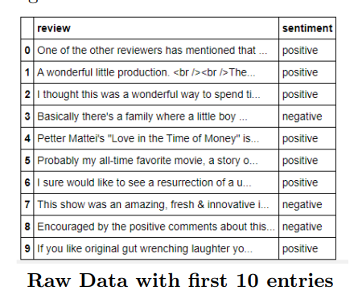
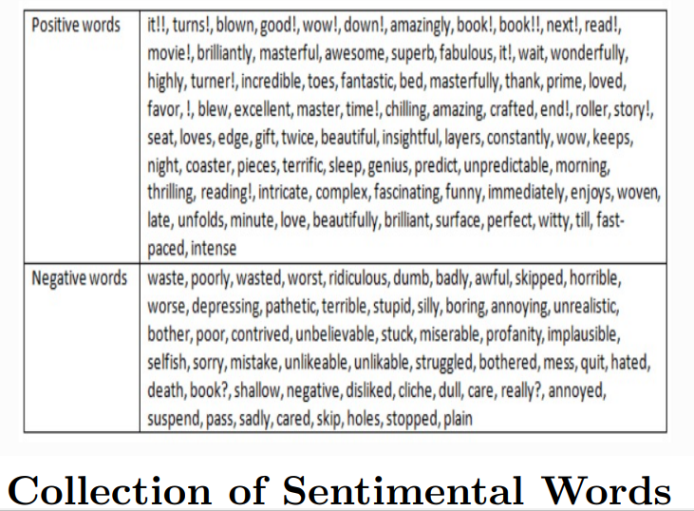
The dataset is having two features one of them is a review and another one is sentiment, there are 49582(Movie Reviews) unique reviews and 2(Positive or Negative) unique sentiments in the dataset. The dataset were not having any null values.

Slide 5
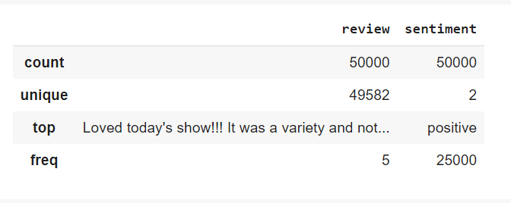

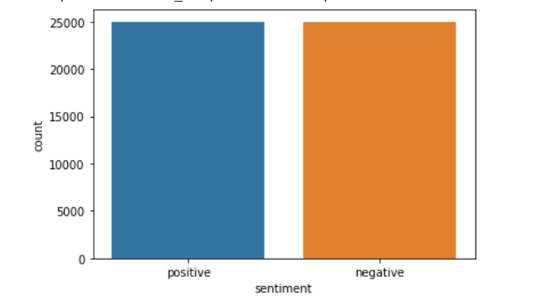
EXPLORATORY DATA ANALYSIS
SUMMARY OF THE DATA
NULL OBSERVATIONS
A BALANCED DATASET

Slide 6
Data pre-processing
The steps we followed for eliminating redundant text from the Reviews. The following steps are performed to estimate the meaningfulness of the data:
I. Removing HTML strips and brackets
Here in data if we have some HTML tags, we need to clean that HTML strips. Also, remove some noisy texts along with square brackets.
II. Removing special characters
As our dataset is in the English language we need to make sure that any special characters are deleted.
III. Stemming the text
Stemming is a technique for eliminating affixes from words in order to retrieve the base form or word stem. The stem need not be identical to the morphological root of the word. The stem of the terms eating eats, and eating, for example, is eat.

Slide 7
IV. Stop Words Removal
Stop words are words that have little or no meaning, these are the most common words in any natural language. For the purpose of analyzing movie reviews, these stop words might not add much value to the meaning of the document. Generally, the most common ones are “the”, “is”, “in”, “for”, “where”, “when”, “to”, “at” etc. The steps given above are a basic necessity for any pipeline which is related to NLP(Natural language processing), the transformed data is then used for analysis. After, this we call our data normalized and fit for passing to any classification-based model.
V. Lowercasing the text
Lowercasing the text data, is one of the simplest and most effective forms of text preprocessing. It is applicable to NLP problems and can help in cases where the dataset is not very large and significantly helps with the consistency of expected output.

Slide 8
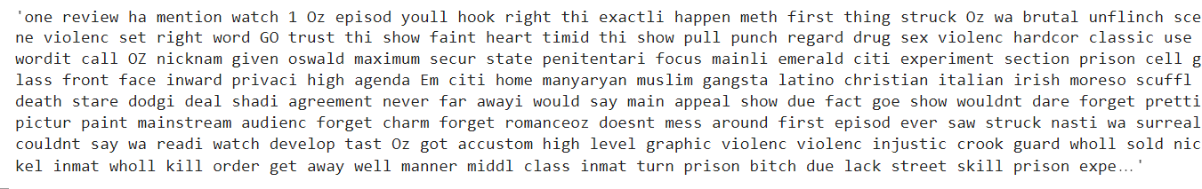
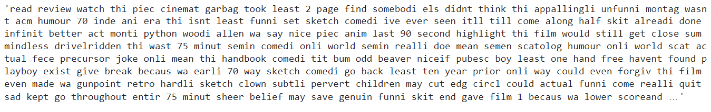
Normalized reviews
FOR TRAINING
FOR TESTING

Slide 9

Bag of words
The bag-of-words (BOW) model is a representation that turns arbitrary text into fixed-length vectors by counting how many times each word appears. This process is often referred to as vectorization.

Slide 10

Tf-idf
TF-IDF stands for “Term Frequency — Inverse Document Frequency”. This is a technique to quantify words in a set of documents. We generally compute a score for each word to signify its importance in the document and corpus.
tf-idf(t, d) = tf(t, d) * log(N/(df + 1))

Slide 11
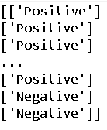
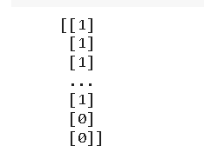
Label binarizer
Label Binarizer is an SciKit Learn class that accepts Categorical data as input and returns an Numpy array.

Slide 12

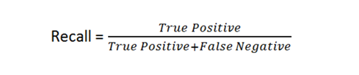
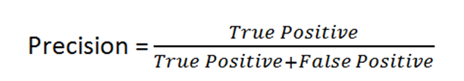
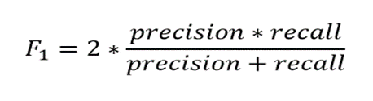
EVALUATION STRATEGY
We have used Accuracy, Precision, Recall, F1 score and Confusion Matrix as our parameters to evaluate our model.

Slide 13
Logistic Regression
Logistic regression is a process of modeling the probability of a discrete outcome given an input variable. The most common logistic regression models a binary outcome; something that can take two values such as true/false, yes/no, and so on. Multinomial logistic regression can model scenarios where there are more than two possible discrete outcomes. Logistic regression is a useful analysis method for classification problems, where you are trying to determine if a new sample fits best into a category.

Slide 14
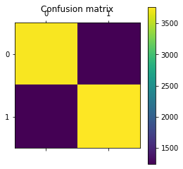
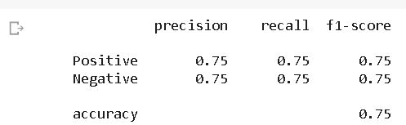

LOGISTIC REGRESSION(bow)

Slide 15
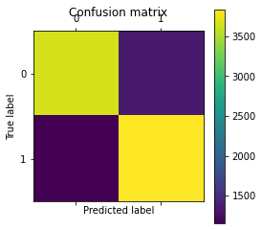
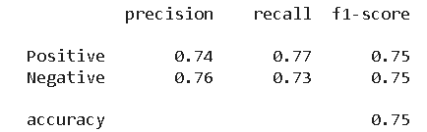

LOGISTIC REGRESSION(tf-idf)

Slide 16
Support vector machine
Support vector machines (SVMs) area family of supervised learning algorithms for classification, regression , and identification of outliers. The goal of the support vector machine (SVM)method is to maximise the margin , which is defined as the distance between the separating hyperplane (or decision border) and the nearest training samples, also known as support vectors. We use the perpendicular distance from the line to just the nearest spots to determine the margin. Also , it uses a subset of training points in the decision function (called support vectors), so itis also memory efficient.

Slide 17
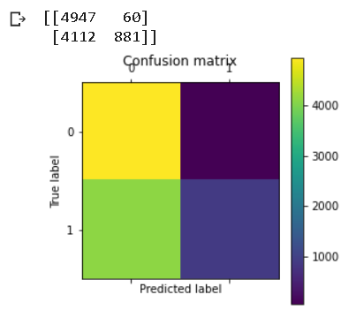
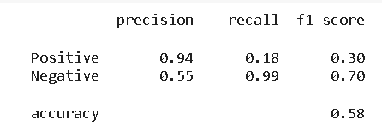
Support vector machine(BOW)

Slide 18
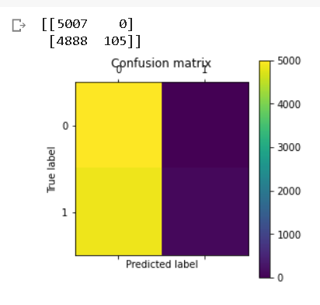
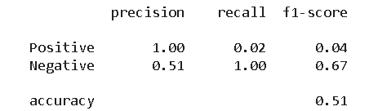
Support vector machine(TF-IDF)

Slide 19
Multinomial naïve bias
One The Naive Bayes technique is an effective way for assessing text input and solving issues involving several classes . Because the Naive Bayes theorem is based on the Bayes theorem, a basic understanding of the Bayes theorem is required. The Bayes theorem, devised by Thomas Bayes, calculates the probability of an event occurring based on prior knowledge of the event’s circumstances. We calculate the chance of class A when predictor B is provided . It’s calculated using the following formula: P(A—B) = P(A) * P(B—A)/P(B)

Slide 20
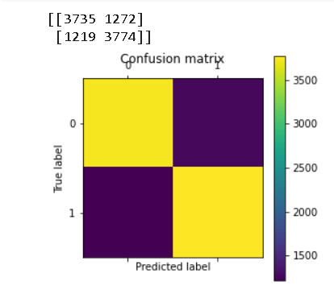
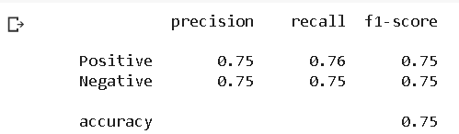
Multinomial naïve bias(BOw)

Slide 21
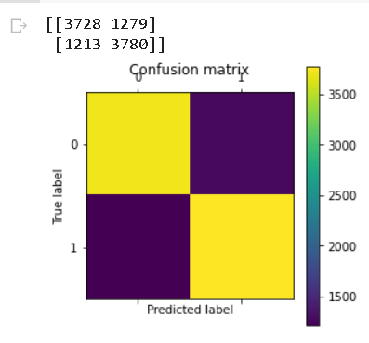
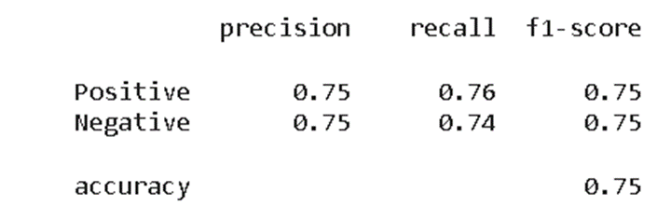
Multinomial naïve bias(tf-idf)

Slide 22
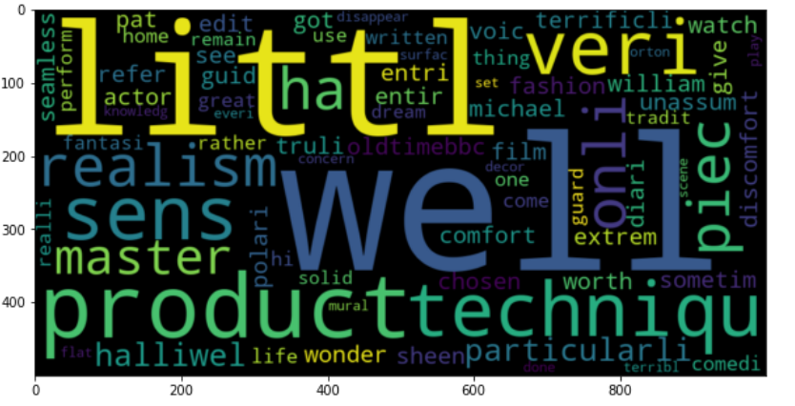
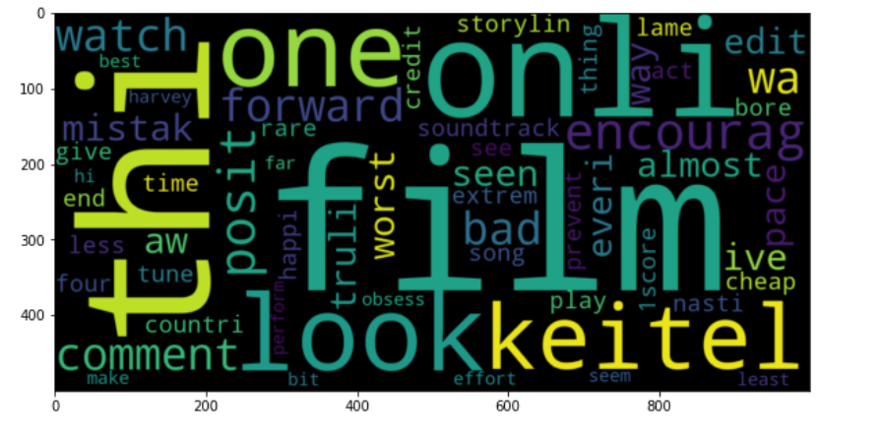
WORD - CLOUD
Word cloud for positive review words after normalizing the data
Word cloud for negative review words after normalizing the data

Slide 23
CONCLUSION
We can observe that both logistic regression and multinomial naive bayes model performing well compared to linear support vector machines.
Still we can improve the accuracy of the models by preprocessing data and by using lexicon models like Textblob.

Slide 24
Future work
Sentiment Analysis on a group of reviews and identified feature expressions taken from reviews will be possible in the future. Rather than being good or negative, we may try to anticipate other attitudes behind the reviews, such as toxic, severe toxic, obscene, threat, insult, and identity hate . We can also try to apply different vectorizations in the future to improve the word matrix. For example, we may try removing the subjects from the phrases. In addition, future research might test more complex models for analysis. For example, because it can account for the link between the sentences, a recurrent neural network may be able to deliver superior results.

Slide 25

THANK you!
MSC Data Science Batch 2021
SEM-II

